Slide 1
Relevance classification of social media posts in disasters(Incremental Learning)
Under The guidance : Dr.Kusum Kumar Bharti
Team Members
Sahil Ahammed 2018216 Pravesh Vajpayee 2018194 Munesh Kushwah 2018342

Slide 2
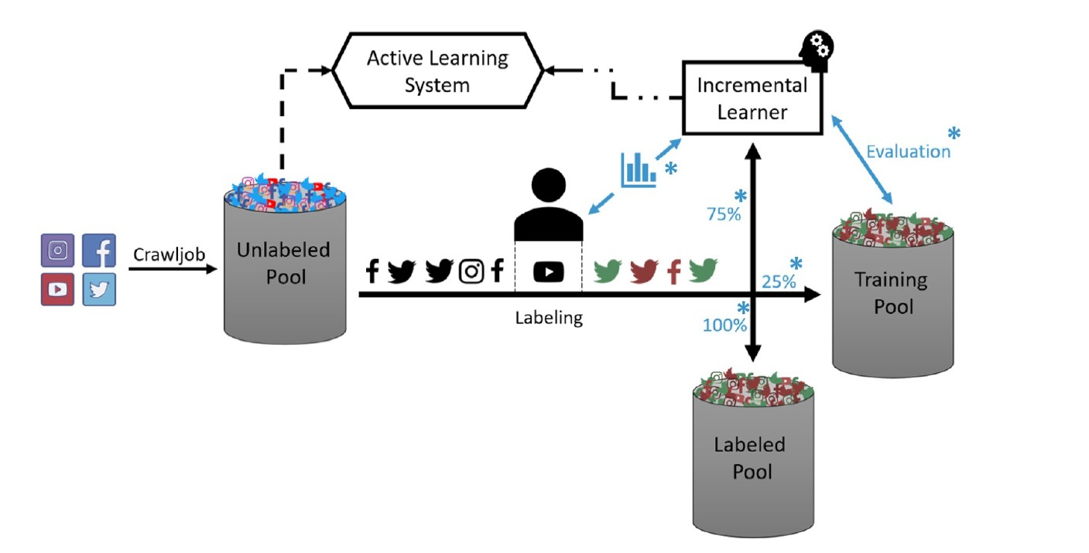

Slide 3
Introduction
Social media allow emergency services to receive valuable information (e.g., eyewitness reports, pictures, or videos) from social media.
The use of social media in disasters and relevance classification to mitigate information overload.
On classification of relevant data, Emergency service can act according to Information
Issue is, As Time progresses the data that is posted in media increase rapidly,
There is a way to train the model without been trained on whole data rather than train on new data, this can be memory and time-efficient

Slide 4
Approach
Incremental learning is a method of machine learning in which input data is continuously used to extend the existing model's knowledge i.e. to further train the model.
Supervised Machine Learning Algorithm
Decision Tree.
Support Vector.
batch learning in logistics regression.
Main Challenges Encounter in Incremental learning is to develop a algorithm such that the parameters won’t forget last data also learn the new data

Slide 5
Requirement of Incremental
As Data Increase the
The every time generated data is not trained with the whole Data
As this exceed time to train the data
After certain turn the ram usage will excess

Slide 6
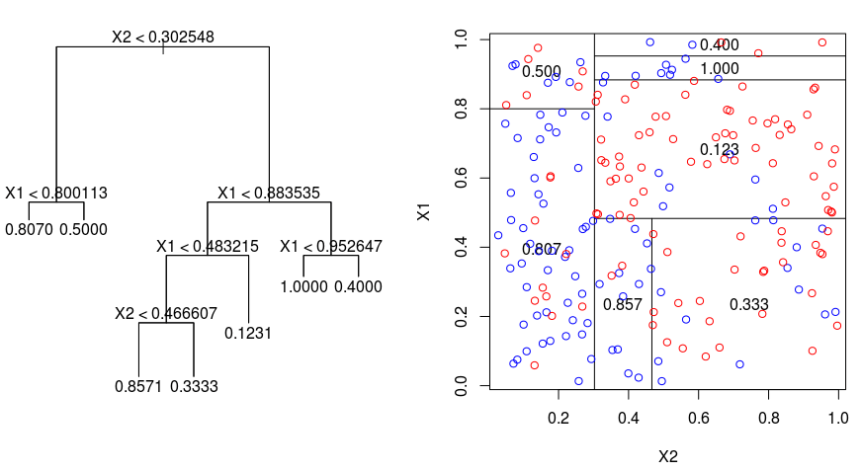
Decision Tree

Slide 7
Decision Tree
func(incremental_decision_tree(clf,feature_detail,new_data)
feature_detail ← update_feature_detail(new_data)
dict ← get_tree_detail(clf)
clf ← Decision_Tree(train,y)
generayed_data ← generate(feature_detail,dict)
combined_data ← combine(new_data , generated_data)
clf ← clf.fit(combined_data)
return clf

Slide 8
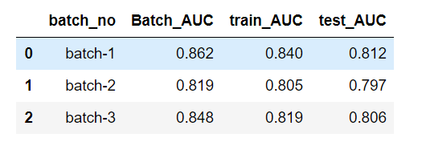
Decision_Tree Performance
The training AUC is improving afer every batch which mean classifier is updating it's knowledge on train-data
The training AUC in Batch_3 is 0.819 and when the entire data is trained AUC of training data is 0.82,
For the test_data AUC in Batch_3 is 0.806 annd for entire_data AUC is 0.804
AUC are nearly same.
googl_collab

Slide 9
SVM
SVM , finds a optimal hyper planes in form of support vector
SVM is trained in training data and a support vector is found
In future new data is added it is then trained using SVM and the support vector obtained is added to the resultant support vector

Slide 10
Incremental learning using-SVM
In this approach we have divided data into three sets and trained three times and used the resultant vector for predicting .
1)We trained an SVM on TR1 (Training Set 1). Then we took the support vectors chosen from TR1, let us call these SV1 (Support vector ).
2) Then we have trained svm on TR2 .Then we have added and added them to SV1+TR2.
3)Again we ran the SVM training algorithm on SV 1 + TR2. At each step, we used the trained machine to classify TE . Now the SVs chosen from the training of SV 1 + TR2 were taken, let us all these SV 2, and TR3 was added to them and the resultant sv’s are stored in sv1 .

Slide 11
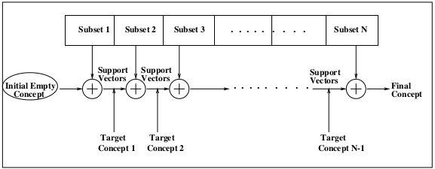
SVM Incremental working

Slide 12
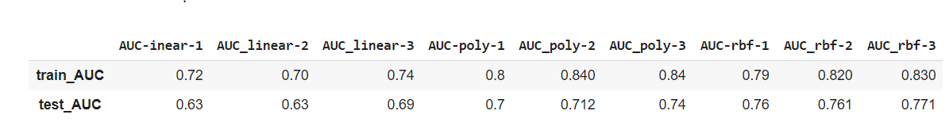
SVM Performance
The training AUC is improving after every batch and it shows that svm is good for incremental training.
For the test data AUC in batch_3 is and for entire_data is AUC is 0.841 which is good.
The training AUC in batch is taking 2 sec and training whole data is 2.5 sec which is time efficient .
From this we can conclude that incremental learning using svm can give good results and will be memory efficient .

Slide 13
Incremental Learning By Logistics Regression
The result is determined by autonomous variables that are dichotomous in nature. Which means only two results are possible.
Logistic Regression (aka logit, MaxEnt) classifier. In the multiclass case, the training algorithm uses the one-vs-rest (OvR) scheme if the ‘multi_class’ option is set to ‘ovr’, and uses the cross-entropy loss if the ‘multi_class’ option is set to ‘multinomial’.
That's implemented in sklearn.linear_model.SGDClassifier, which fits a logistic regression model if you give it the option loss="log"

Slide 14
Incremental Learning By Logistics Regression
With SGDClassifier, like with LogisticRegression, there's no need to wrap the estimator in a OneVsRestClassifier -- both do one-vs-all training out of the box.
lr = SGDClassifier(loss="log")
To train on minibatches, use the partial_fit method instead of fit. The first time around, you have to feed it a list of classes because not all classes may be present in each minibatch:
for xs, ys in minibatches: lr.partial_fit(xs, ys, classes=classes)

Slide 15
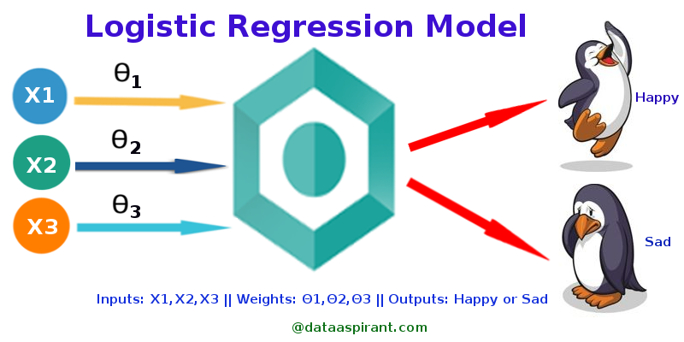
Logistic Regression Model

Slide 16
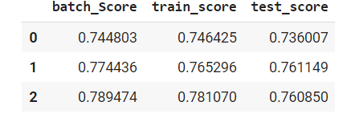
Logistics Regression Performance

Slide 17
THANK YOU

